Slide 1
Council of Small Towns PFAS Updates – October 19, 2023
Presented by: Ray Frigon, Director, Remediation Division
Bureau of Water Protection and Land Reuse

Slide 2
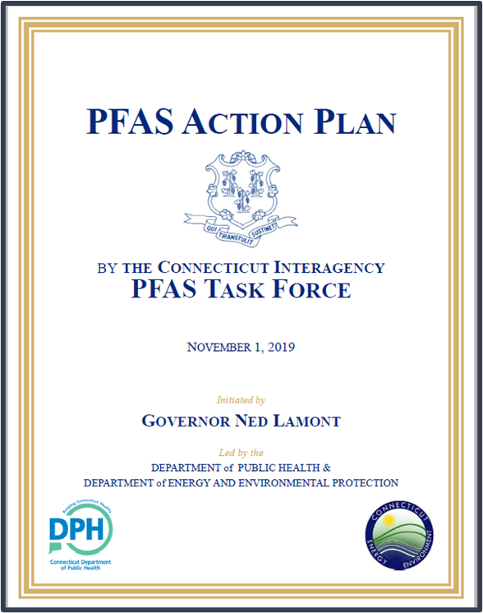
2019 PFAS Action Plan Review
Comprehensive strategy for protecting Connecticut’s citizens from PFAS exposure and protecting the environment from the effects of PFAS pollution.
34 recommended actions
4 Strategic Focus Areas:
Protecting the Health of CT Citizens
Pollution Prevention
Remediation
Education, Outreach and Communication
Notes:
Lori and Graham/Ray

Slide 3
Toxics in Packaging law
Public Act 21-191 updated Connecticut’s Toxics in Packaging Law (Section 22a-255g-m of the Connecticut General Statutes (CGS):
As soon as feasible, but not later than December 31, 2023, no food package to which PFAS has been intentionally introduced during manufacturing or distribution in any amount shall be offered for sale or for promotional purposes in this state by its manufacturer or distributor.
Questions: Tom Metzner at 860-424-3242 or tom.metzner@ct.gov.
https://portal.ct.gov/DEEP/P2/Industry/Toxics-in-Packaging-Legislation
Food packaging - any package or packaging component that is applied to or in direct contact with any food or beverage.
PFAS - all members of the class of fluorinated organic chemicals containing at least one fully fluorinated carbon atom.
Intentionally introduced - deliberately utilized PFAS in the formulation of a package or packaging component where the continued presence of such PFAS is desired in the final package or packaging component to provide a specific characteristic, appearance or quality.

Slide 4
Department of Energy & Environmental Protection
Actions Implemented:
GIS Mapping of Potential PFAS Sources to Prioritize Future Environmental Sampling Across Connecticut
State Funding to Prevent Future PFAS Releases and Test/Treat Private Wells with PFAS pollution
2020 - $2M Bond funding received for AFFF Take-Back Program & private well testing
FY22-FY23 – Additional funds allocated by State Bond Commission in Dec 2021
$1.15M each year for private well testing and treatment
FY24-FY25 – State biennial budget provides $3M/$2M for PFAS activities
Connecticut Department of Energy & Environmental Protection
Notes:
DEEP’s Role – Primarily Pollution Prevention & Remediation focus
Planning for an AFFF Take-Back Program began in 2019 prior to the State’s PFAS Action Plan
June 2019 - Advisory Bulletin issued on AFFF use
June 30, 2021 - Alternative Fluorine-Free Foam (F3) identified for use in state fire apparatus

Slide 5
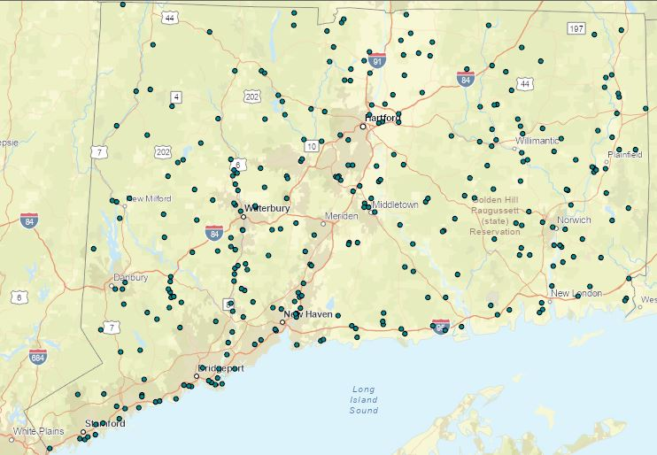
ONGOING PFAS PROJECTS: Potable Water Testing
Killingworth, East Hampton, Thompson, Greenwich, Chester, Suffield
DEEP sampled private wells
Provided bottled water as needed
Installed treatment systems where PFAS exceeds DPH Drinking Water Action Levels
Conducted environmental testing to identify PFAS sources
Provided guidance to municipalities and local health
Connecticut Department of Energy & Environmental Protection
Notes:
Killingworth and East Hampton sites were referred to DEEP by DPH following PFAS detections in public water systems in these communities.
East Hampton – ID’ed a few homes with PFAS, provided treatment
Killingworth – extensive # of wells tested, # treatment systems installed, what to say about the source??

Slide 6
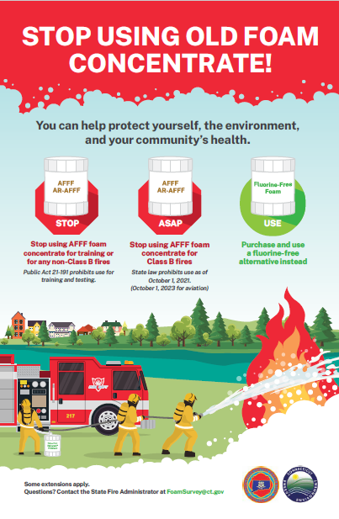
ONGOING PFAS PROJECTS: AFFF Ban
Implemented Legislation Banning AFFF Use
CGS Section 22a-903a (PA 21-191) – AFFF Use Ban
Banned firefighter training with AFFF upon passage, July 13, 2021
Banned most AFFF uses as of 10/1/21
Directed DEEP to initiate an AFFF Take-Back Program (began April 2021)
Connecticut Department of Energy & Environmental Protection
Notes:
Killingworth and East Hampton sites were referred to DEEP by DPH following PFAS detections in public water systems in these communities.
East Hampton – ID’ed a few homes with PFAS, provided treatment
Killingworth – extensive # of wells tested, # treatment systems installed, what to say about the source??

Slide 7
AFFF Updates
NOVs are being issued by DEEP for AFFF releases!
Ban interpretation note: It is not a violation to possess AFFF – violation occurs when it is released.
REMINDERS & CAUTIONS:
Do NOT dispose of empty AFFF containers in regular trash!
Remind firefighters not to use any remaining on-board AFFF
Use external eductor with Green (fluorine-free) foam concentrate
This Photo by Unknown Author is licensed under CC BY-SA

Slide 8
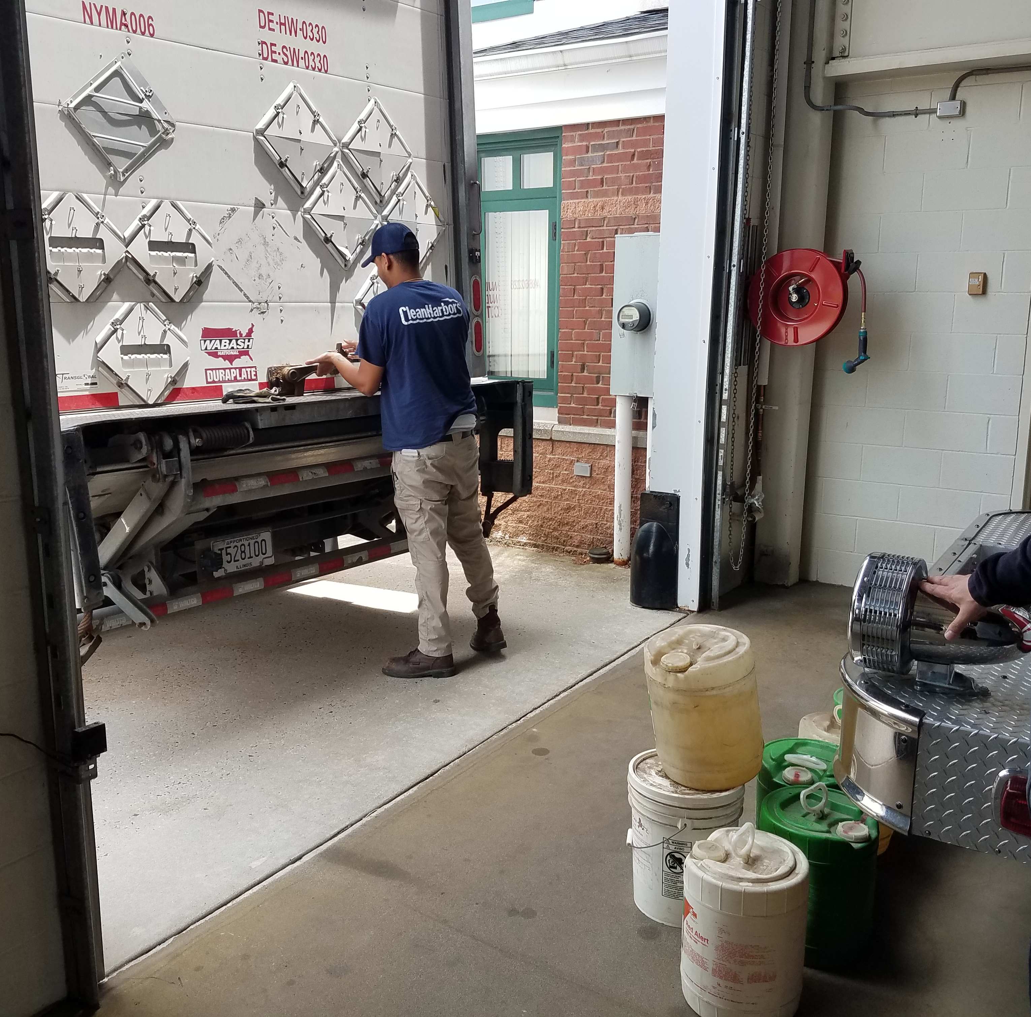
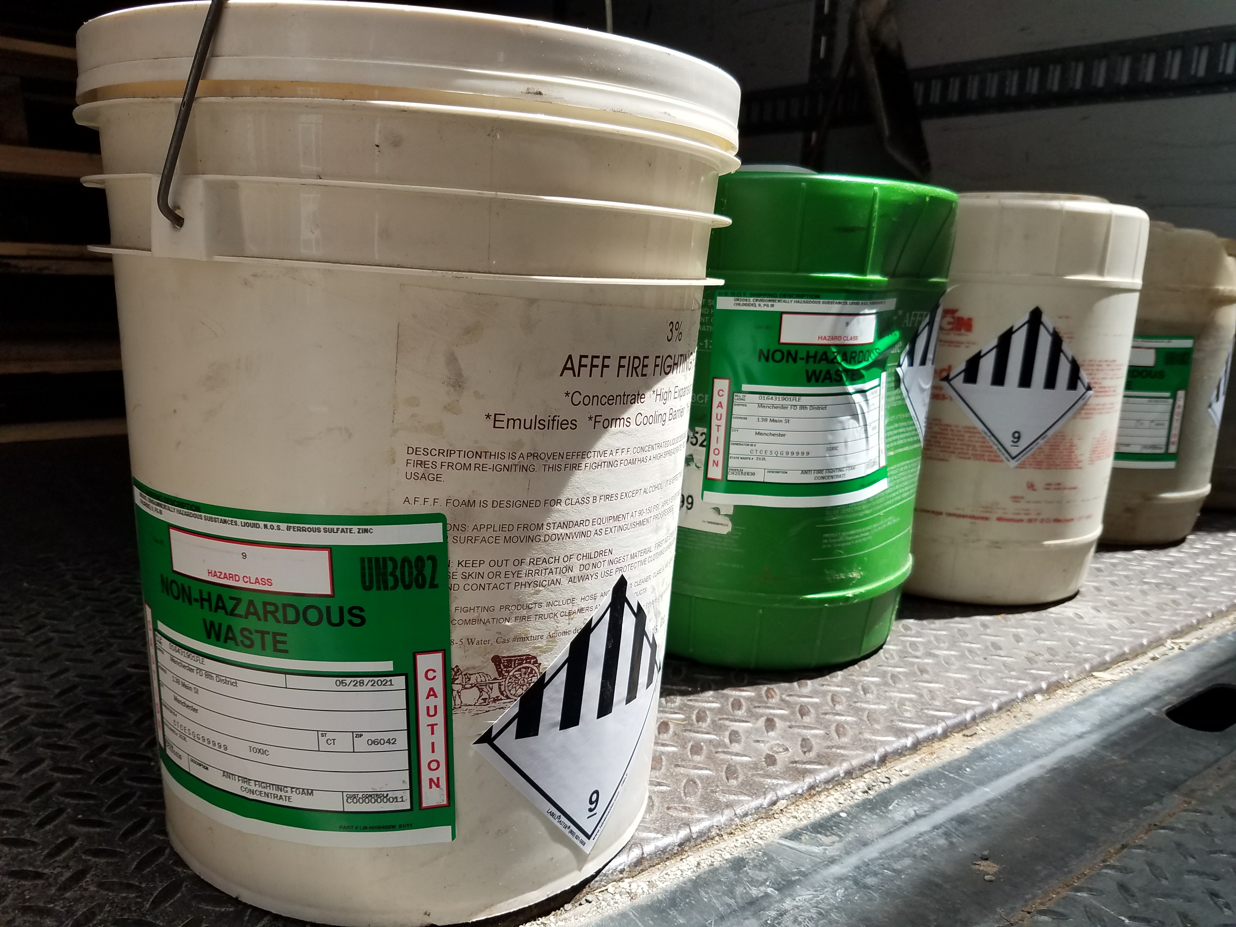
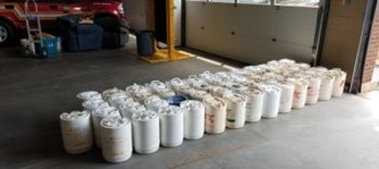
AFFF Take-Back Program
Joint DEEP/DESPP Effort – CT Leads the Nation
Phase 1 – Container Collection & Disposal of AFFF concentrate from state/municipal fire departments
Launched in April 2021; Completed March 2022
35,300 gal.+ collected from >250 town fire departments
Cost of approx. $850,000 for pick up and safe disposal of AFFF in containers
Phase 2 – PFAS Decontamination Study/ Regional Foam Trailer Cleaning:
Summer 2021-2022
Purchase of new foam trailers is underway
Phase 3 – Dispose of AFFF from ~400 municipal fire trucks: Pending
Connecticut Department of Energy & Environmental Protection
Notes:
Pollution Prevention – Key Action in Action Plan
Talk about AFFF releases to Farmington R. in 2019 – foam – bank to bank, fish consumption advisory
8 regional foam trailers, ~400 muni fire trucks, ARFF vehicles at 4 Part 139 airports, 1 fixed system at rail yard
Containers vs. onboard apparatus
Clean Harbors – state removal & disposal contractor, milk runs, $800,000 to date
Disposal at Sarnia, ON facility solidification/LF
Key take-aways from Decon study: Proprietary cleaning agents were more effective at reducing PFAS than plain water rinses (>99% vs. ~95% removal)
However, residual PFAS levels remain following use of proprietary cleaning agents that will still cross-contaminate new Fluorine-Free Foam (F3)
Significant Logistics and Cost
→ Decision to purchase new trailers

Slide 9
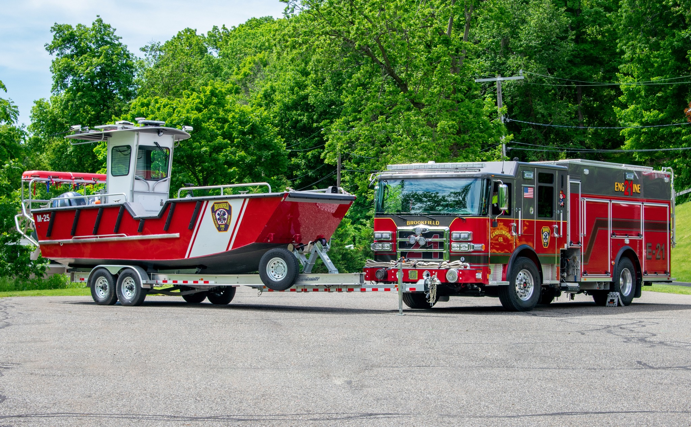
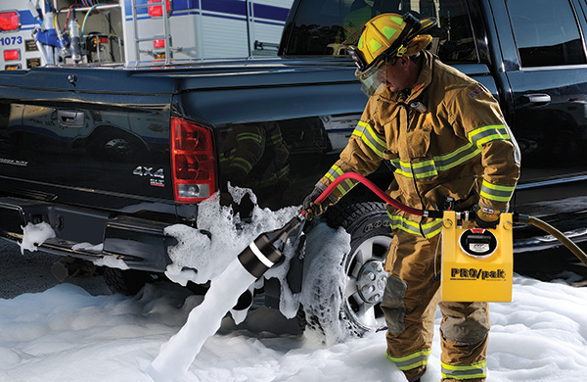
AFFF UPDATES
DESPP $3M funds to be used during FY24:
Municipal fire apparatus decontamination/conversion and AFFF disposal
Fire boats and PRO/paks are eligible
Details on reimbursement program pending from DESPP

Slide 10
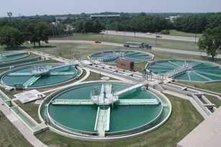
ONGOING PFAS PROJECTS:
Wastewater & Landfills
DEEP Sampled 1/3 of Publicly-Owned Treatment Works (POTWs) (35)
September 2021 – March 2022
Influent, effluent, sludge at all 35 POTWs
Scrubber water at 4 POTWs with incinerators
Surface water and fish tissue samples from 10 receiving waters
Report available at: PFAS in Municipal Wastewater Treatment Plants
Industrial Wastewater Discharge Permit Screening for New Permits and Renewals
Landfill Leachate & Groundwater Monitoring Initiated
PFAS sampling at landfills subject to Superfund and Stewardship Permits issued through the RCRA Corrective Action process
Connecticut Department of Energy & Environmental Protection
Notes:
Publicly owned treatment works
Good cross-section from highly residential to significant commercial/industrial input
No surprises based on studies performed in other states, found PFAS
Evaluating next steps: could include testing of more POTWs to determine baseline conditions

Slide 11
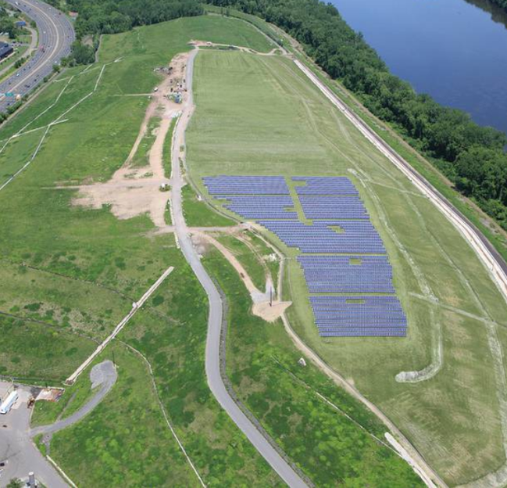
PFAS Monitoring at landfills
Plan to include sampling PFAS in on-site monitoring wells for an initial round of testing.
Subsequent rounds of testing may be required, depending on results and/or presence of nearby receptors.

Slide 12
more information for municipalities:
PFAS Information for Municipalities (ct.gov)
PFAS Information Handout for Municipalities
Firefighting foam
Drinking water well sampling information
PFAS-Free Product Procurement
State contracts available to Municipalities
Who to call?

Slide 13
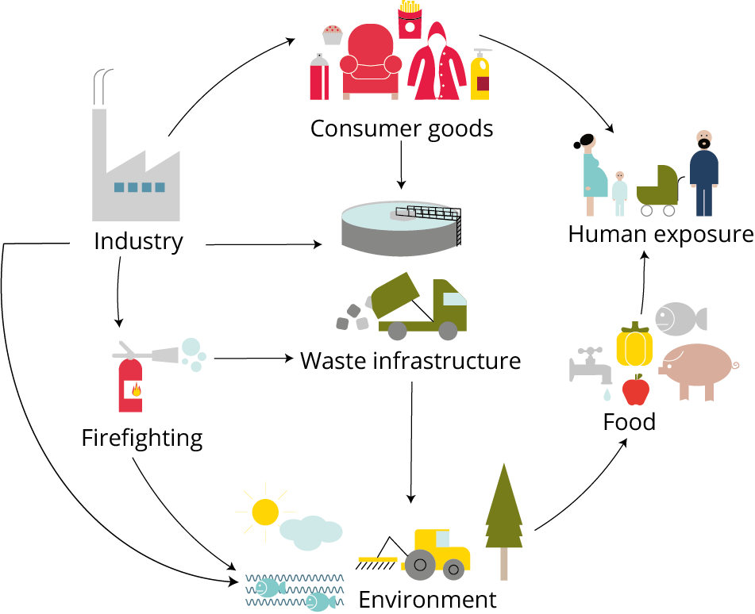
Meghan Lally PFAS Lead Environmental Analyst III CT DEEP Remediation Division Meghan.Lally@ct.gov 860.424.3061
General Inquiries: DEEP.PFAS@ct.gov DEEP PFAS Webpage
This Photo by Unknown Author is licensed under CC BY

